Slide 1



MATERIALS PRICE TRACKER
Build Trends
Alexandra Spencer, Charlie West, Chi-Yun Chen, Cruise Kelly-Evans, Seray Wright, Tong Zhi & Younes El Khatib

Slide 2


40
CHALLENGE
30
Can we create a tool that allows us to track the price trends of key materials such as steel, concrete, copper and currency fluctuations?
20
10
0
Steel
Concrete
Copper

Slide 3
THE OUTPUT
Output 1
A web scraping tool to scrape prices of key materials including steel, concrete and copper as well as currency fluctuations.
Output 2
A dashboard to display these prices, price trends over time and key analytics.​
Output 3
A plan to deploy this solution into a production environment.

Slide 4



CHALLENGE APPROACH
Web Scraping
Machine Learning
Power BI Dashboard
We used python, requests and Beautiful Soup to scrape current data from several public websites.
Time series prediction using SARIMA model on historic data in python, as a method for forecasting future prices.
We fed in the web scraping and machine learning data to create a powerful dashboard.

Slide 5


WEB SCRAPING
Metals
Construction tools
Dates and prices
London Metal Exchange
www.lme.com
Tools and prices
Premier Plant Hire
www.premierplanthire.co.uk/for-hire

Slide 6
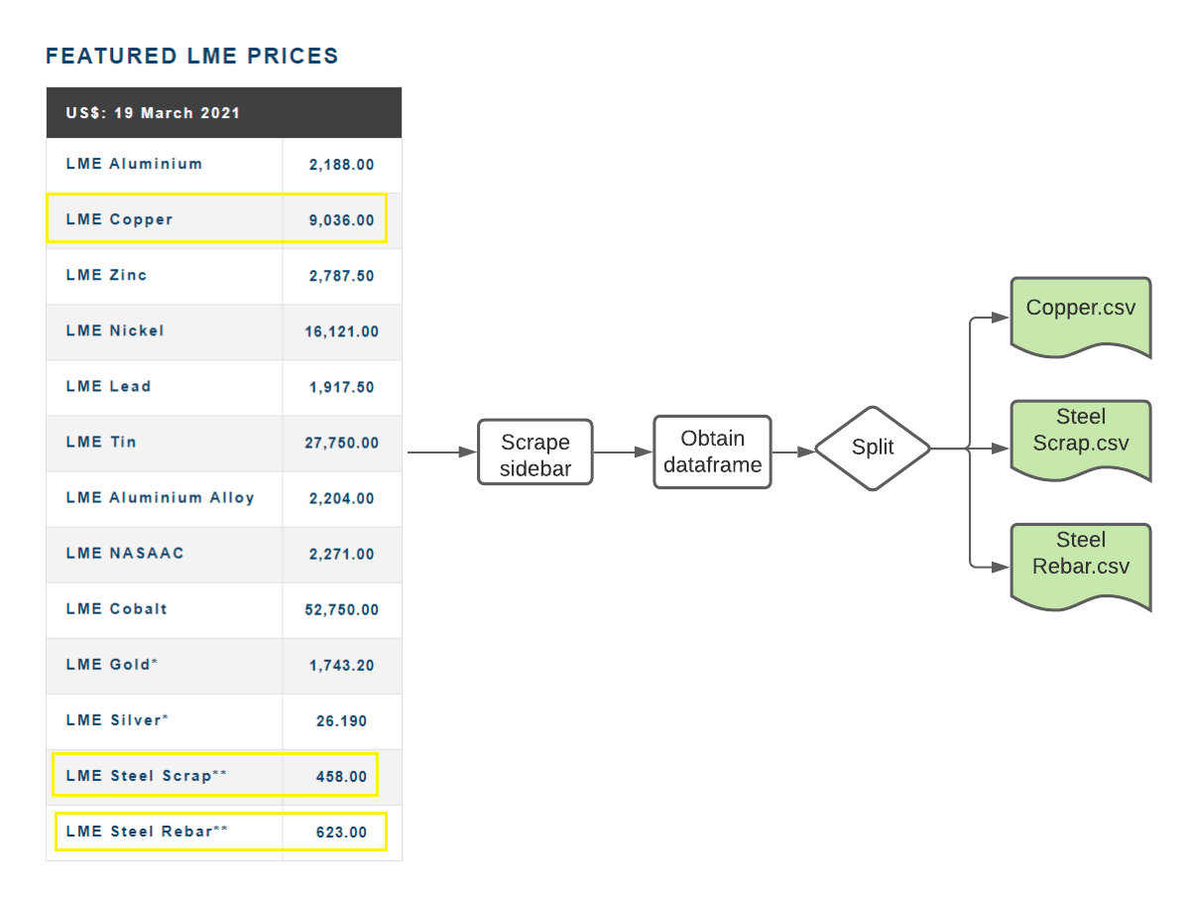
WEB SCRAPING - Metals

Slide 7
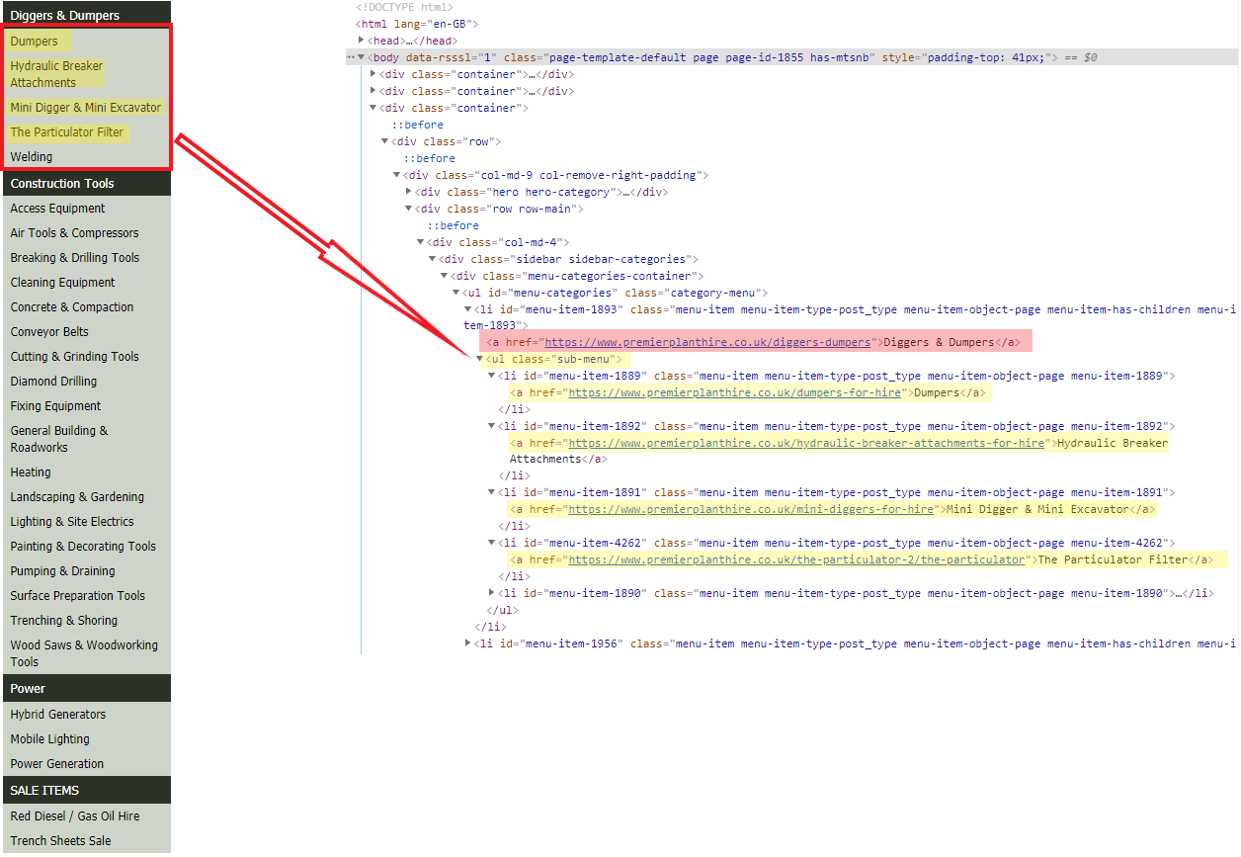
WEB SCRAPING - Tools

Slide 8
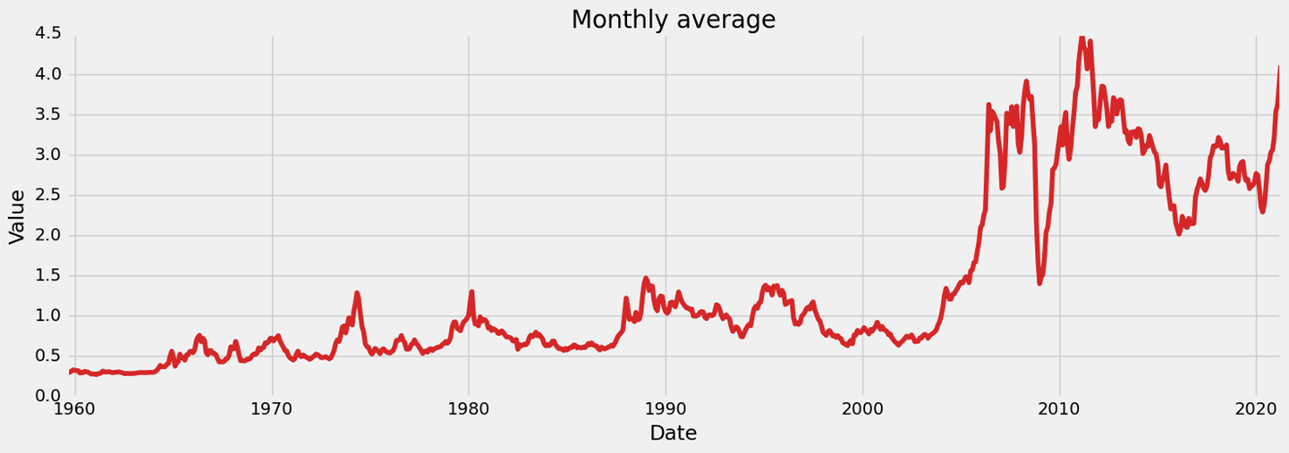
MACHINE LEARNING
Initial Analysis
Notes:
We started the process by an initial analysis of the historic data, and as you can see after 21st century the price for copper has increased significantly. The data exhibits a trend which is one of the factors we had to account for in order to conduct the Time Series Analysis.

Slide 9
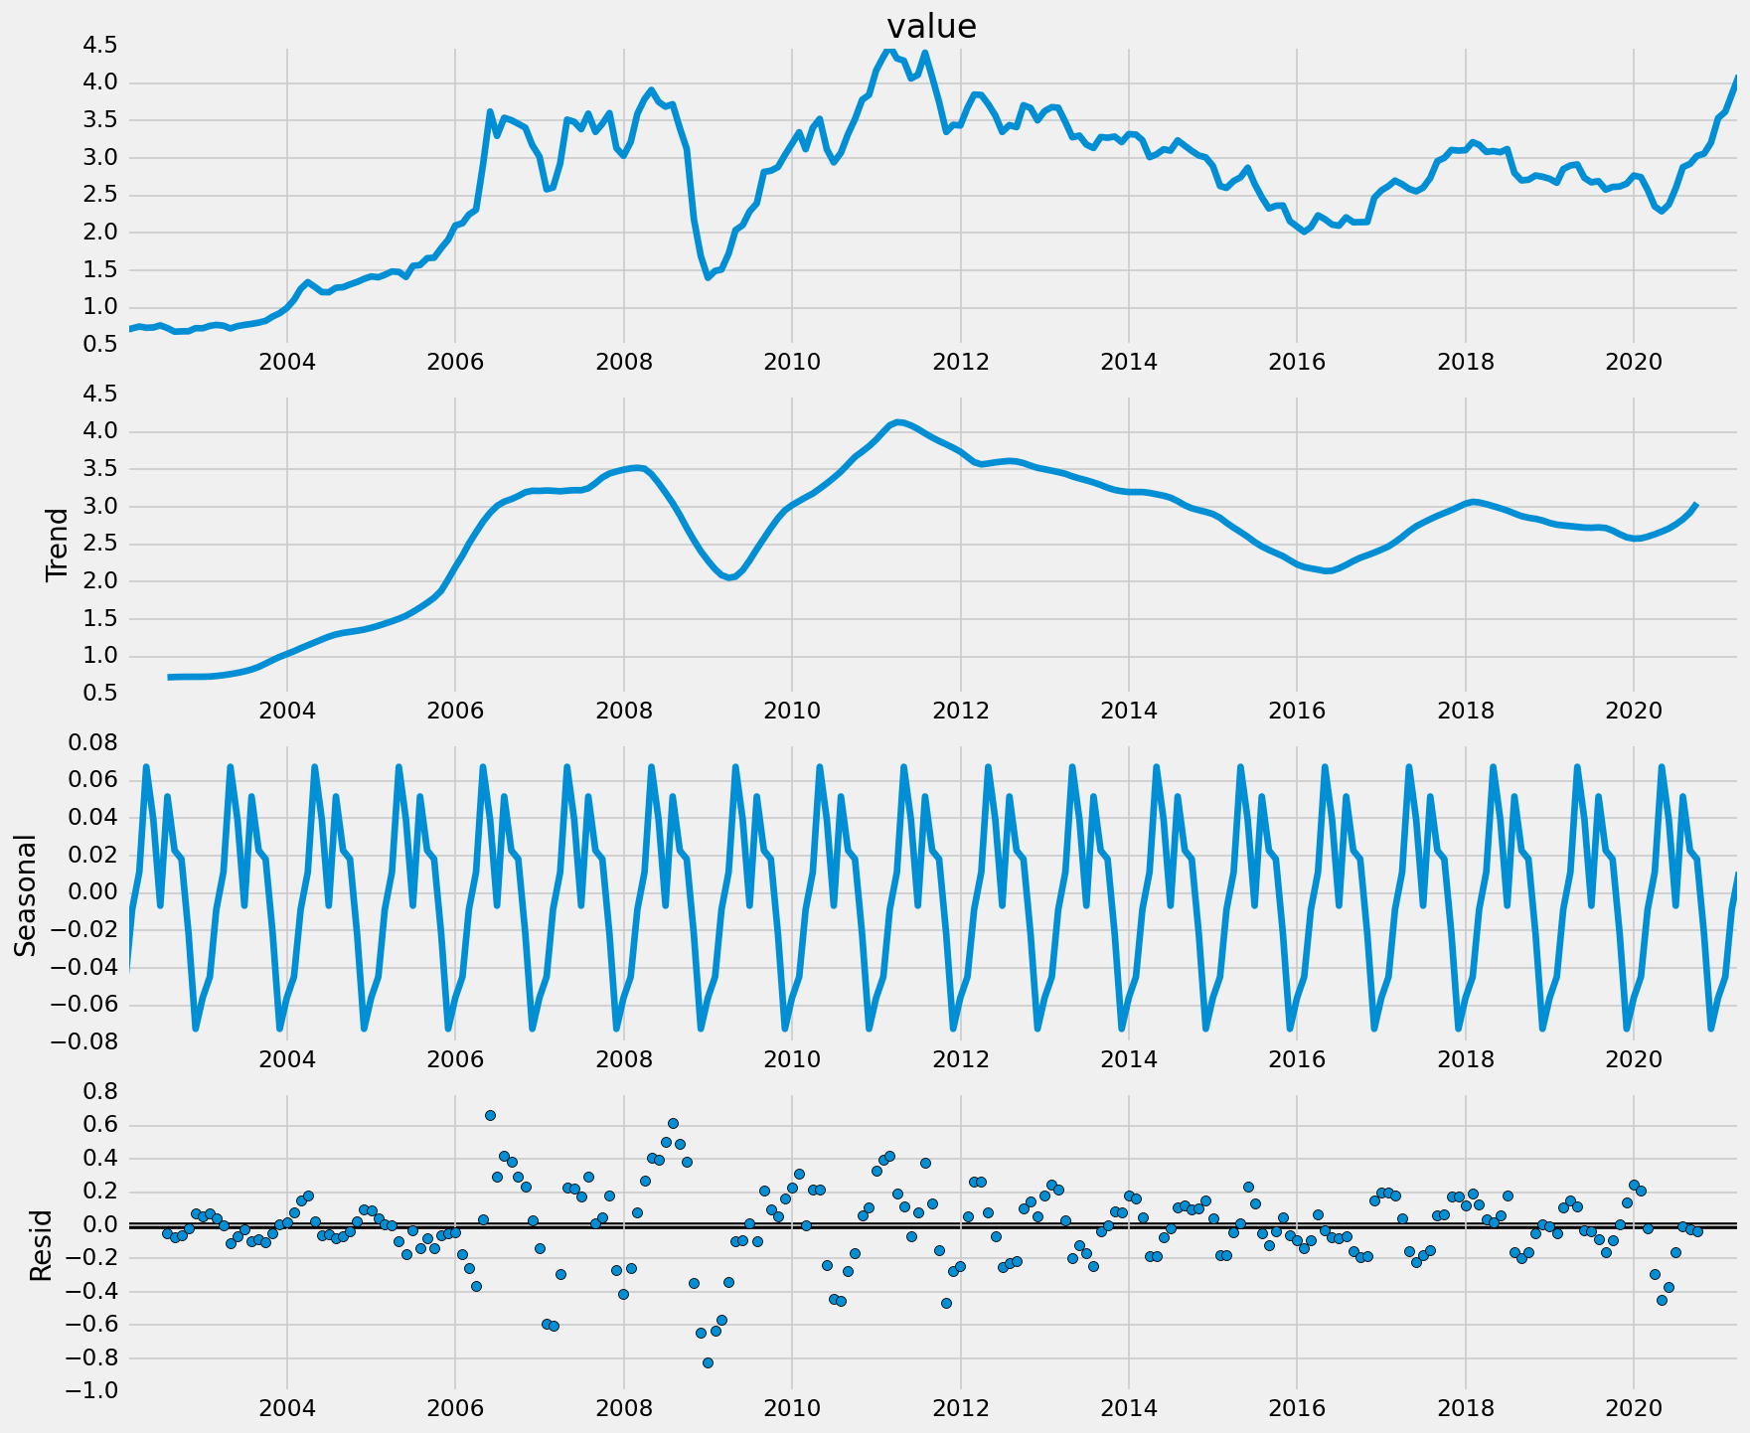
MACHINE LEARNING
Graphical Analysis
Notes:
The preprocessing of the data started by separating it into 3 parts that consists of trend seasonality and residual and as you can see the residual(error graph at the bottom) shows the shock that happened during a 20098 financial crisis.

Slide 10
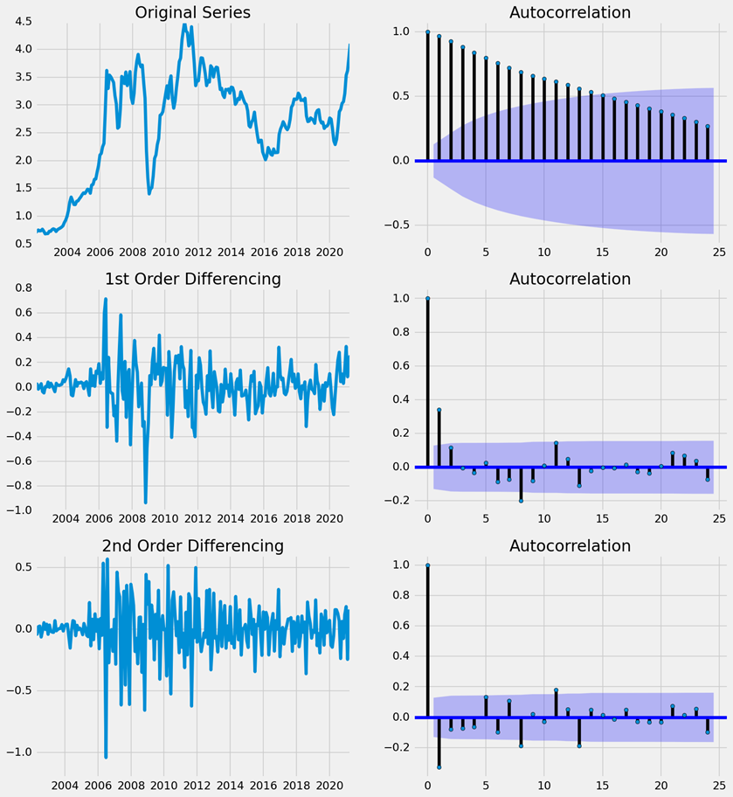
MACHINE LEARNING
Graphical Analysis
Notes:
In order to find the best parameters that works for each dataset we had to calculate the autocorrelation which shows how much each month is related to the previous one. The data was turned into stationary data by removing both the trend and seasonality factors.

Slide 11
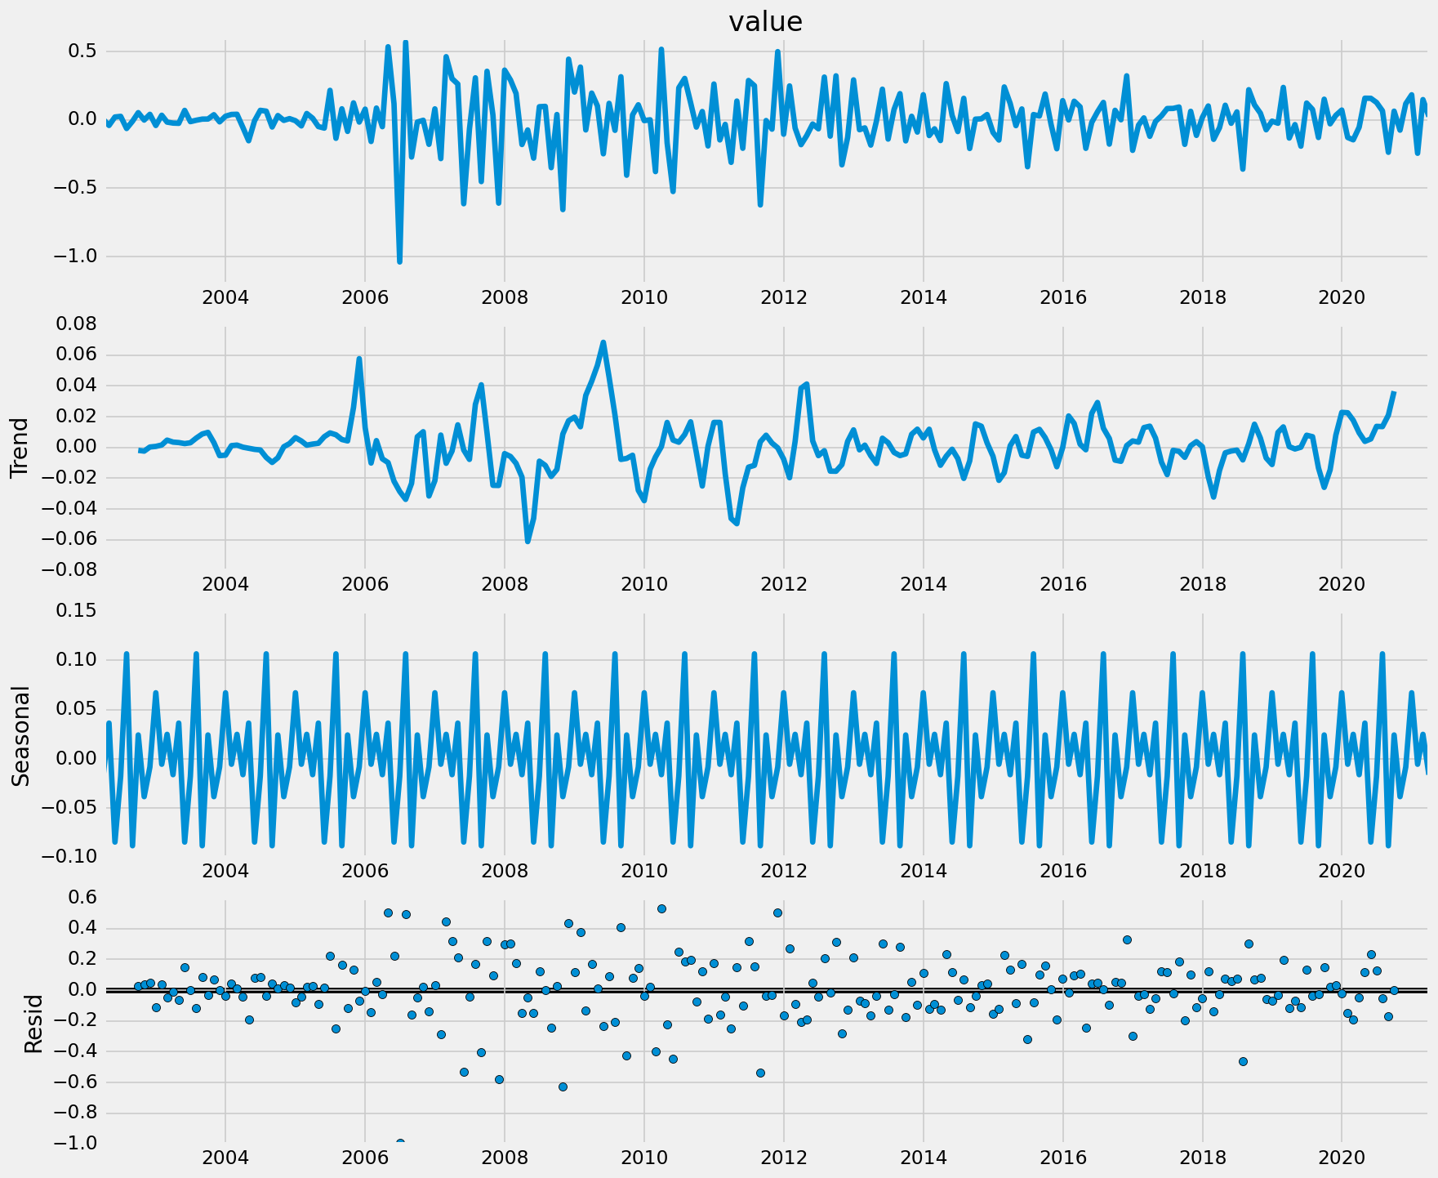
MACHINE LEARNING
Graphical Analysis
Notes:
After differentiating the data by a factor of 1, the data became more stable and the trend had a mean of zero, so we ready to implement the model

Slide 12
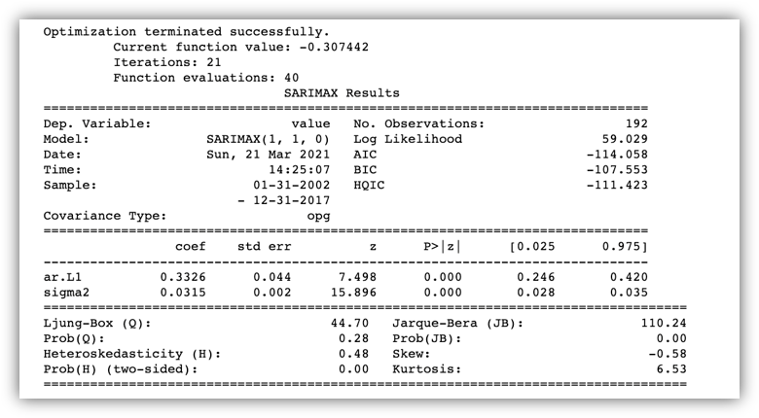
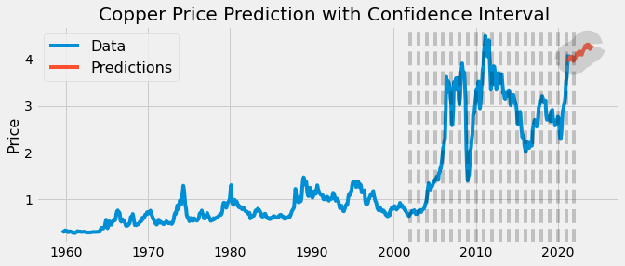
MACHINE LEARNING
Model Results for Copper
Notes:
As you can see, the shaded area was used as training set. we did not account the prices of copper before 2002, due to the drastic change in the industry.

Slide 13
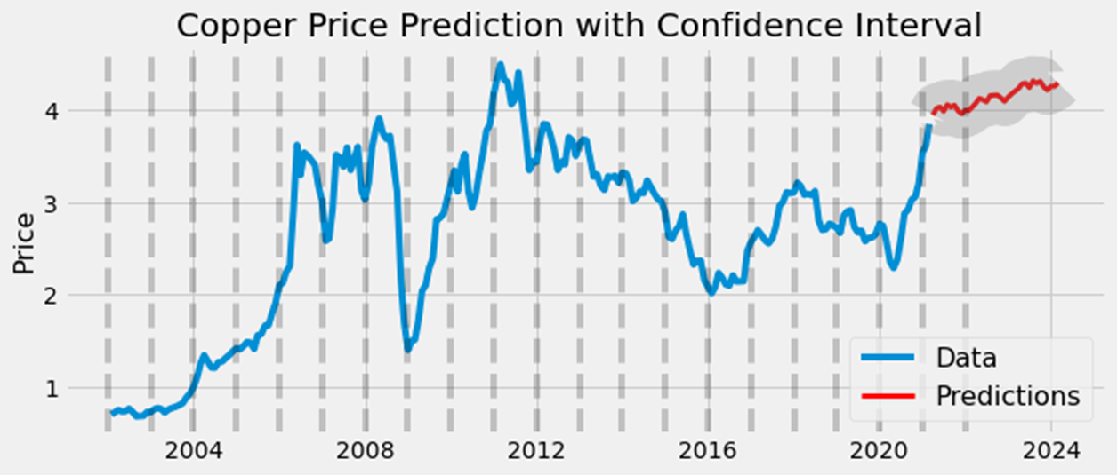
MACHINE LEARNING
Model Results for Copper
Notes:
Zooming in the recent year, we predicted the price three years after today.
The redline showed the price will slightly raised, and the gray part is the potential of adding confidence interval to copper.

Slide 14
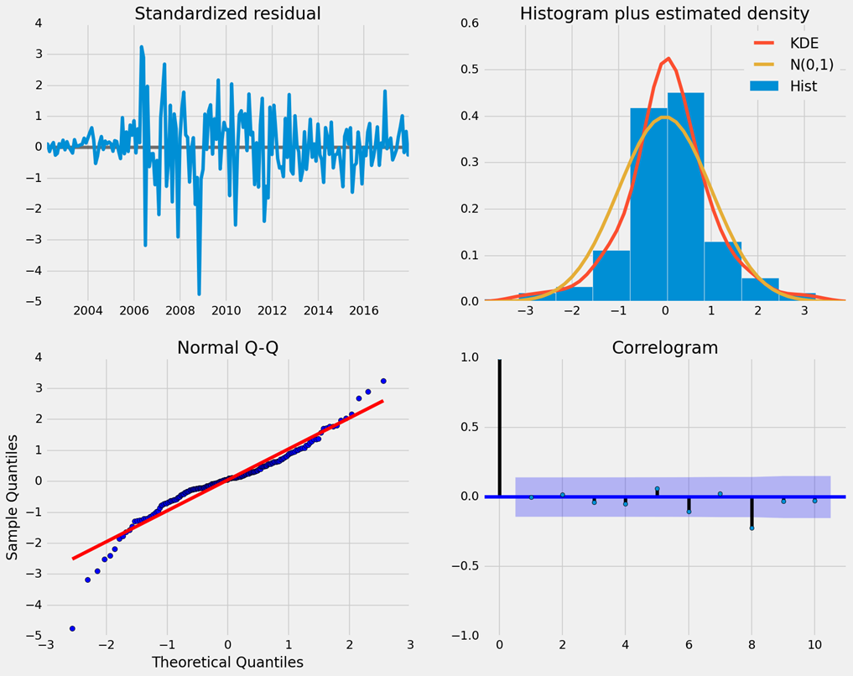
MACHINE LEARNING
Model Analysis
Notes:
As a last step, we conducted model validation to make sure our model is a good fit, and would be able to predict future prices with significant accuracy.
One of the examples is the graph on the bottom left, the QQ plot, proving that the residual is following a normal distribution, which is one of many validations conducted, this can be proven by an empricial visualisation of the blue dotted line which fits the red line with relative accruacy

Slide 15
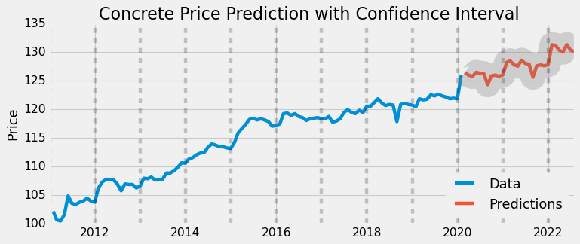
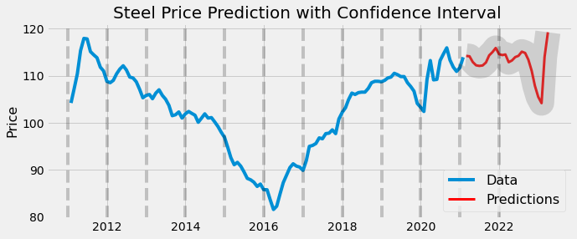
MACHINE LEARNING
Model Application– Concrete and Steel
Notes:
We then applied the aforementioned process to concrete and steel data. However, please note that due to the time ocnstraint, we were not able to find the best dataset, as well as optimising the parameters used in the models/

Slide 16
MACHINE LEARNING
Potential
Adding additional variables (S&P 500 Performance, currency, interest rates, inflation, etc.)
Additional machine learning approaches: Neural network and GARCH
Better accuracy and consistency in concrete and steel data
Notes:
Potential:
THese algotihems provide unlimited possibilities, however, we do need to address the issue of data. As well as S&P 500, inflation and interest rates. Lastly, other machine learning techniques like nerual network could be inplement

Slide 17


POWER BI

Slide 18


QUESTION 1
How would you recommend Gleeds host the productionised solution?
Notes:
Cruise to answer

Slide 19


QUESTION 2
How have you accounted for "unusual" activity (i.e. covid-19) in the data when training your predictive models?
Notes:
The lockdown in the UK affected many industries, many of these industries faced this challenge when conducting time series analysis.
The construction industry was less affected because they were allowed to operate during the pandemic. So one of the asssumptions that we made is that Covid-19 is a shock that could happen to any market and since construction industry as a whole is one of the main buyers of these types of products.Our model takes into consideration that shock that covid had on the prices.
Smoothed out residuals for finnancial crisis already for all the materials. For covid 19, when it comes ot steel and concrete, we did not have to do anything because our analysiss show that prcing residual are consistnet. For copper, we did

Slide 20

QUESTION 3
Some of the data you have is just a snapshot in time. How long would it take to collect enough data to get time series insights from these areas?

Slide 21
CONTACT
Alexandra Spencer: a.ungureanu-spencer@rgu.ac.uk
Charlie West: chgwest@gmail.com
Chi-Yun Chen: chi-yun.chen@postgrad.manchester.ac.uk
Cruise Kelly-Evans: cruise.kellyevans@macegroup.com
Seray Wright: seraywright@live.co.uk
Tong Zhi: tzhi0307@gmail.com
Younes El Khatib: younes.elkhatib@postgrad.manchester.ac.uk
Project Sponsor
James Garner: james.garner@gleeds.com

